Slide 1
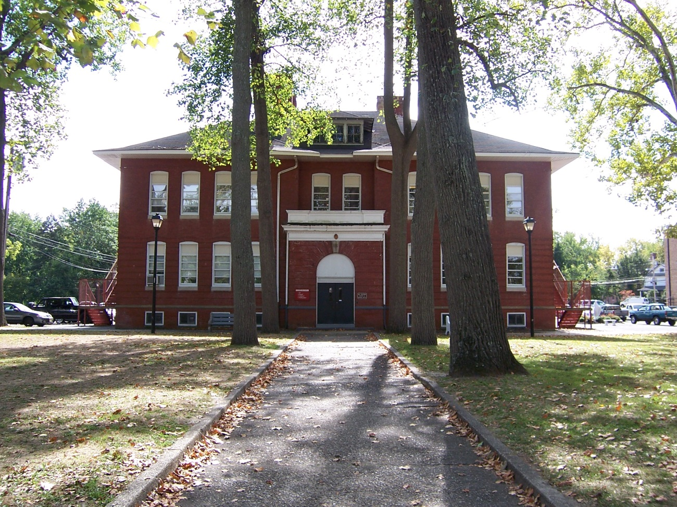
THE STORY OF ST. JOSEPH
by Brody Gallagher

Slide 2
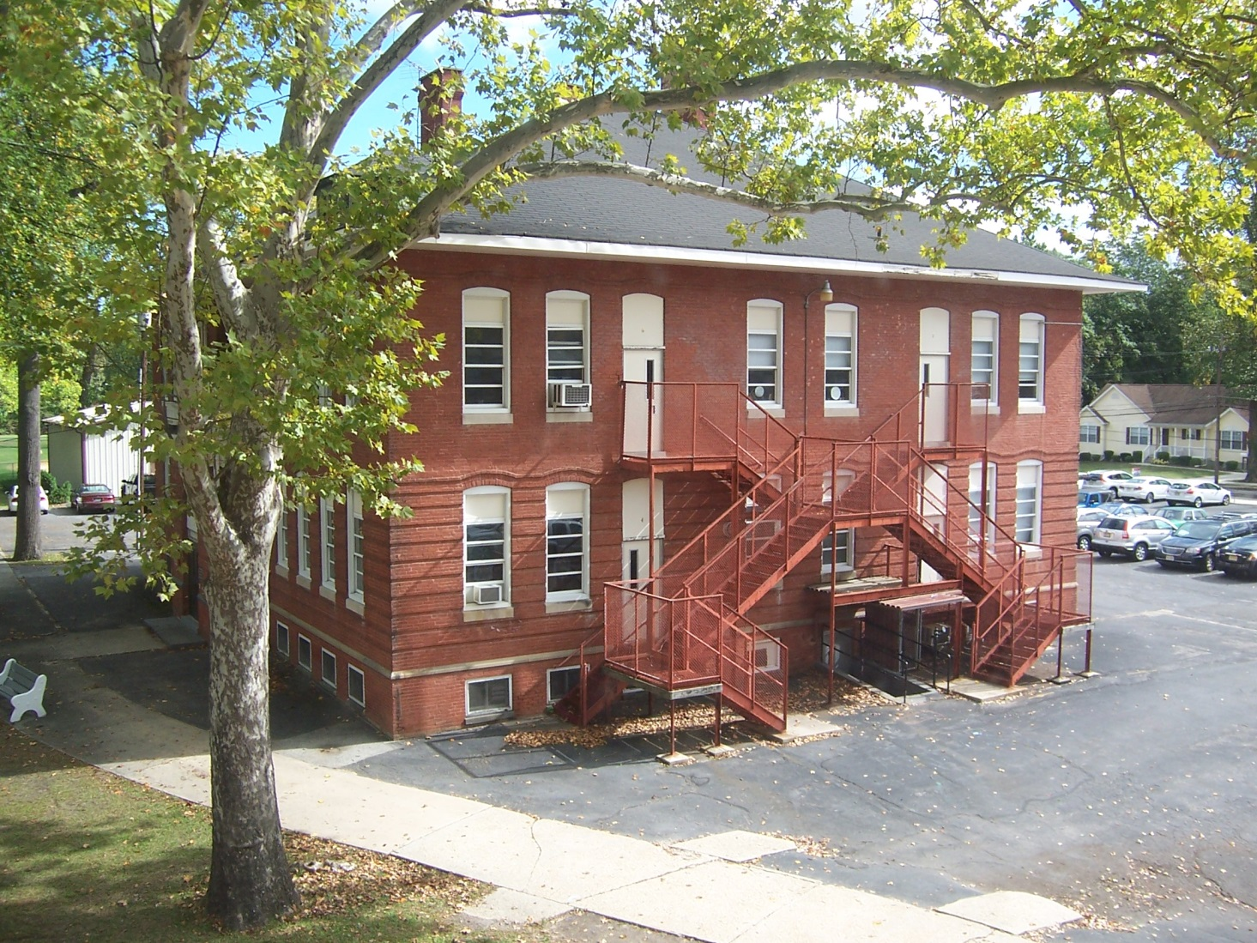
I intended for this image to capture the beauty of the St. Joseph High School campus. I thought that the red brick building would be a perfect way to do so.

Slide 3
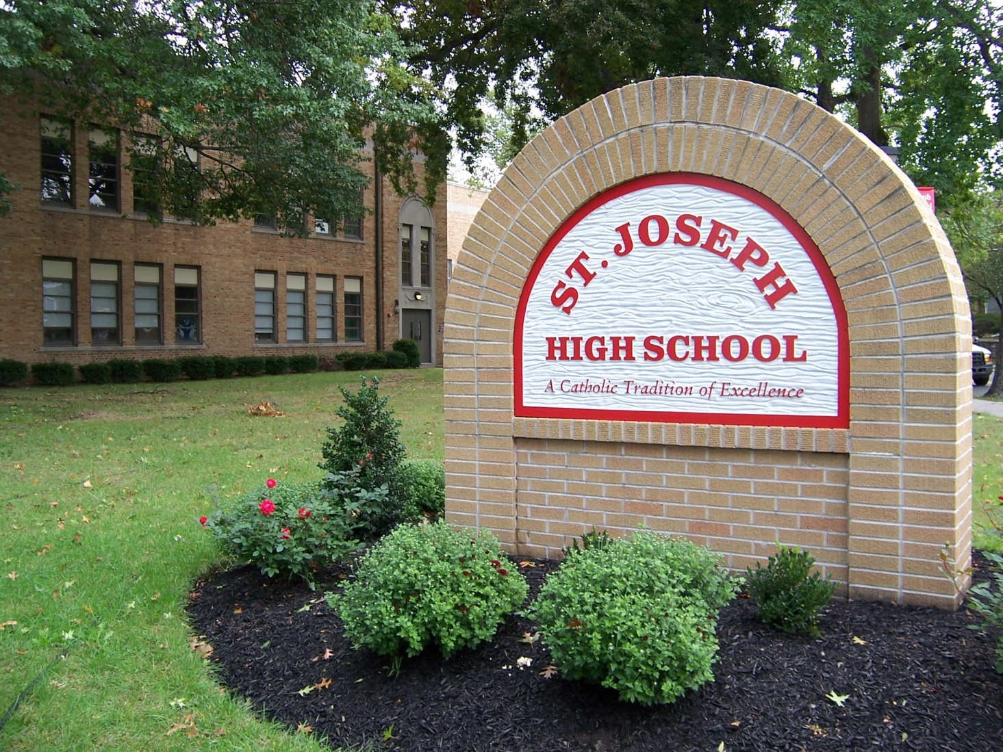
This photograph is meant to show the school itself and the environment surrounding it. It shows the tranquility of the St. Joseph environment.

Slide 4
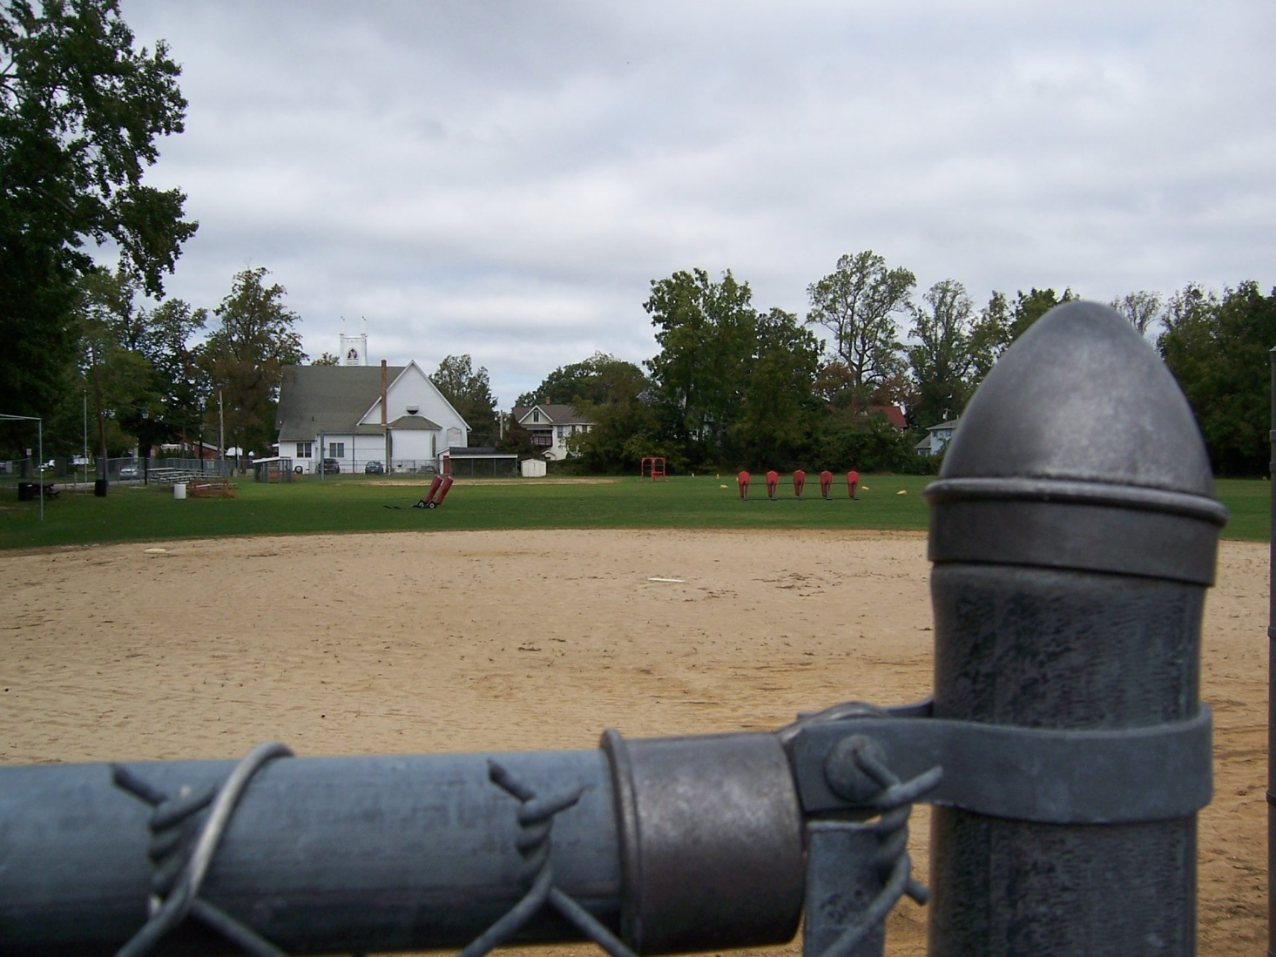
This photo shows the vast field that St. Joseph has for athletics. The openness of the area is shown by the presence of small foreground objects and large background objects.

Slide 5
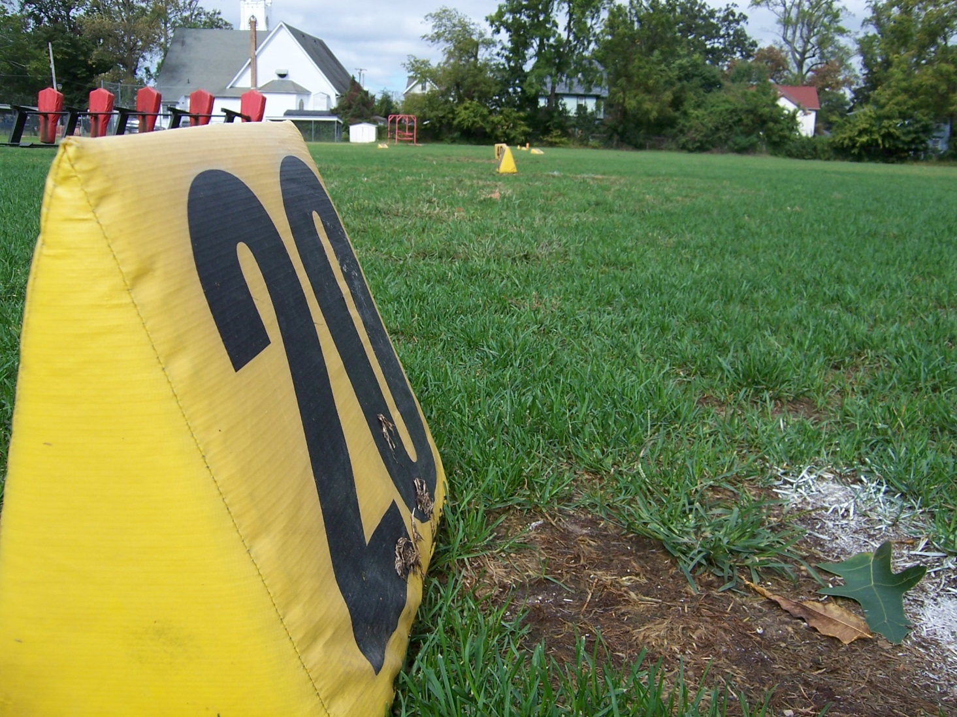
This picture uses the football equipment on the field to show St. Joseph’s focus on football.

Slide 6
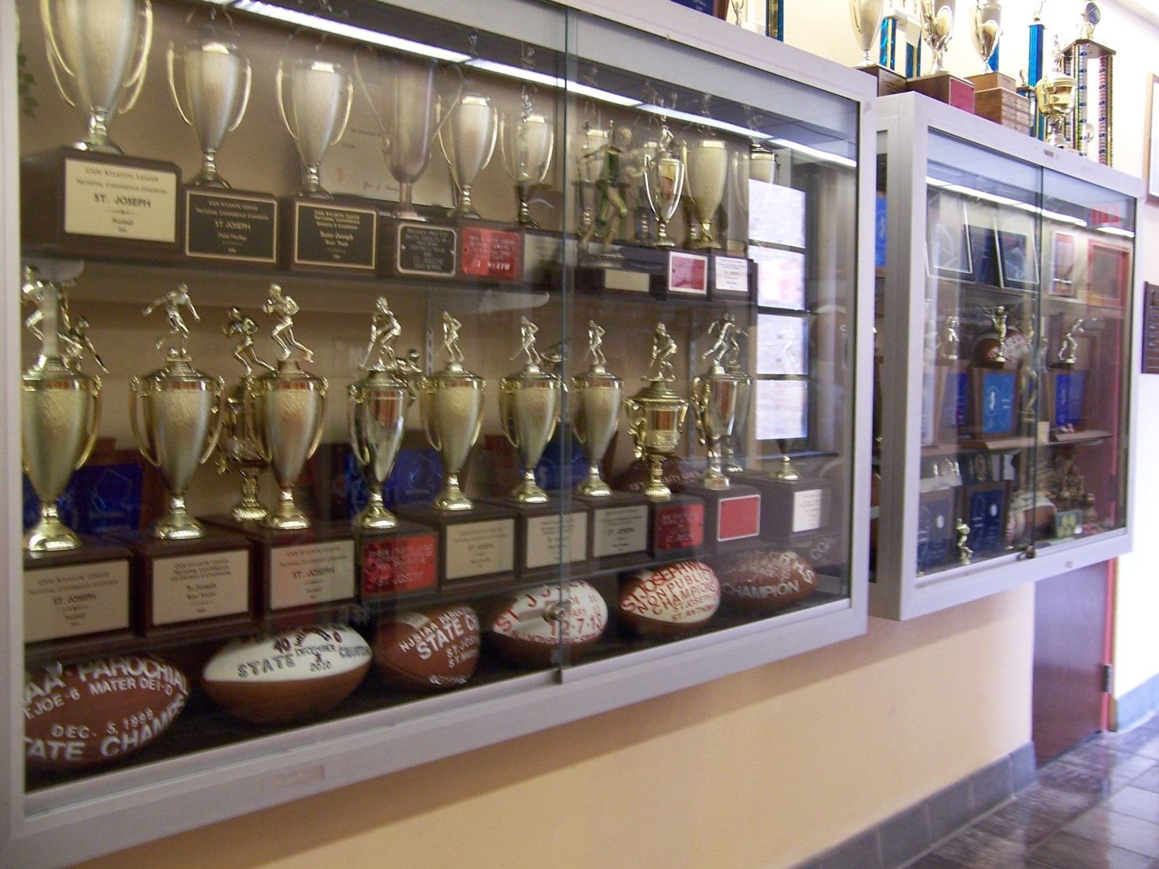
This picture displays Saint Joseph High School’s history of athletic success by showcasing the school’s trophies.

Slide 7
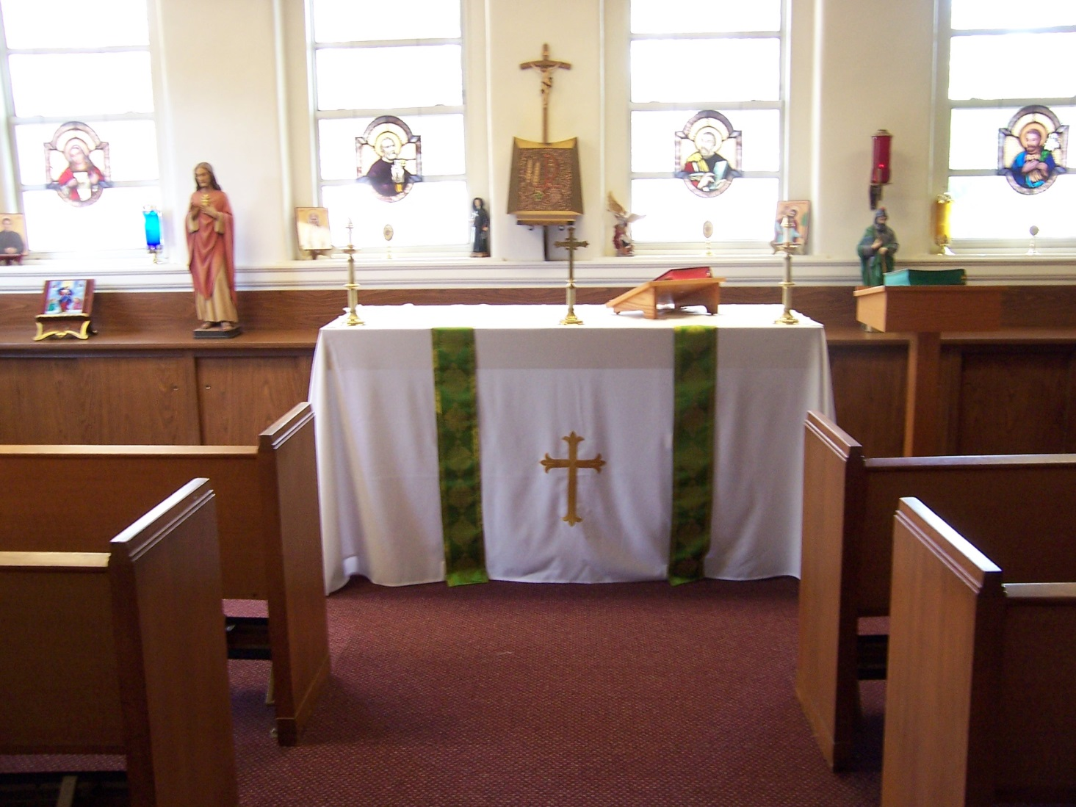
This photograph displays the school’s strong
bonds with the Christian faith.

Slide 8
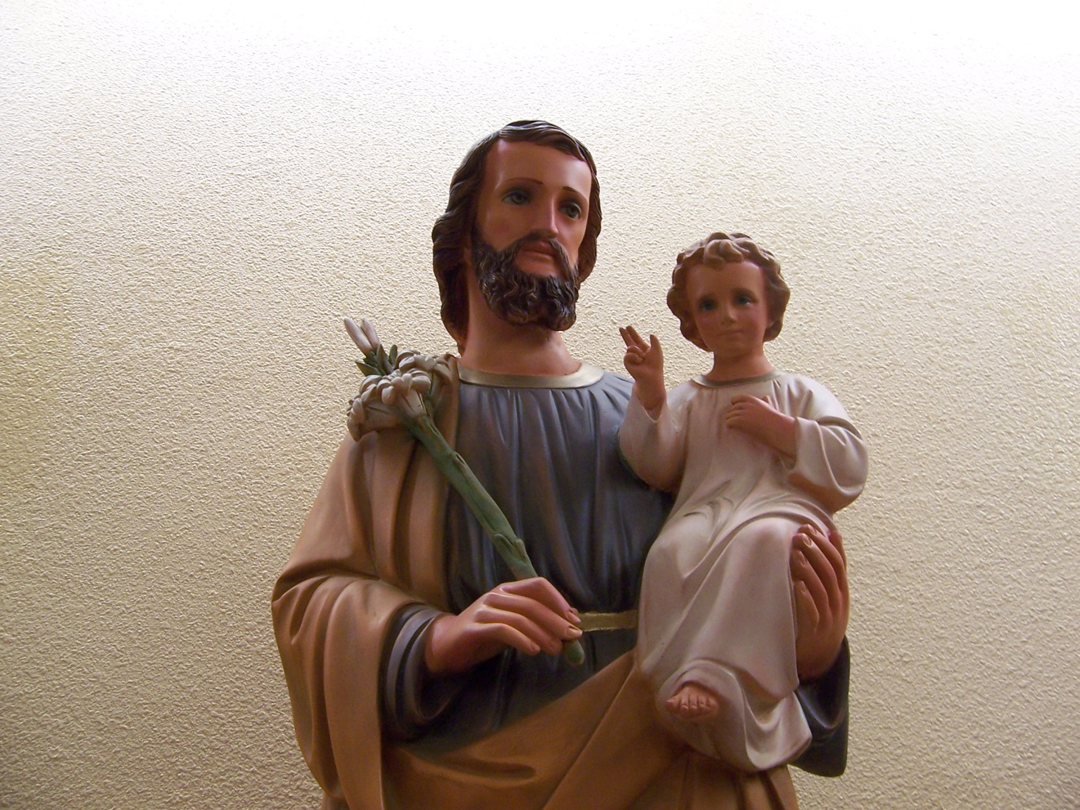
This picture shows how Saint Joseph himself is a role model and an example of faith for every student at St. Joseph High School.

Slide 9
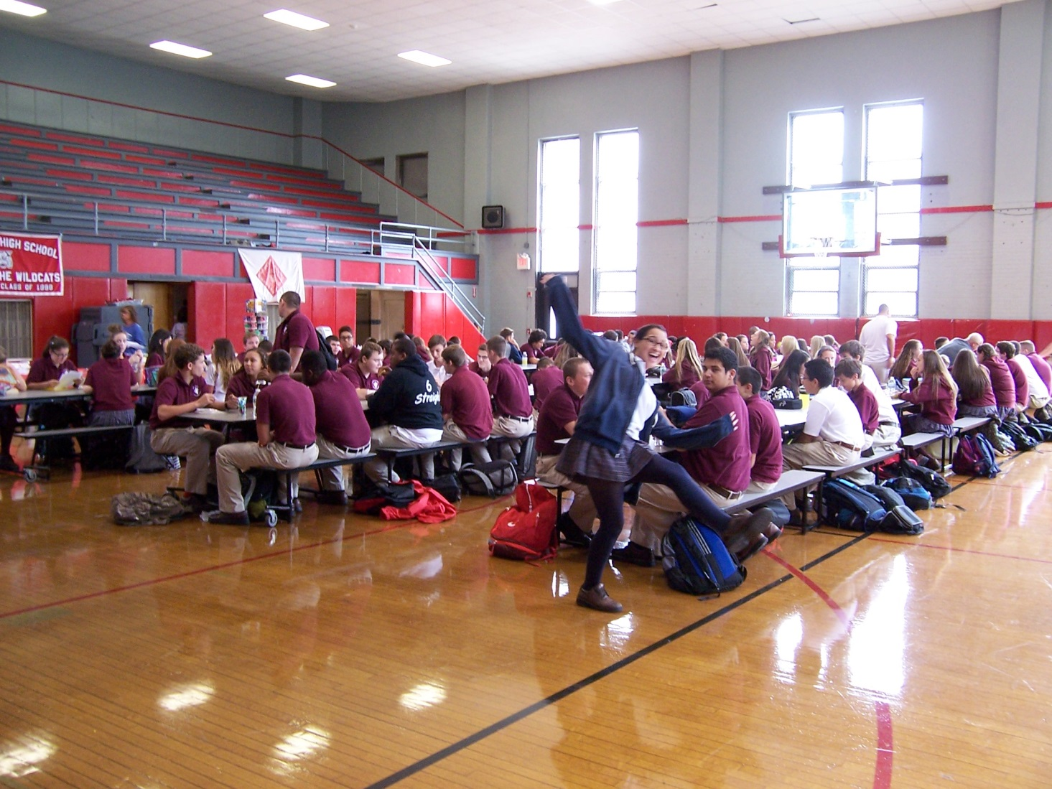
This photograph shows the lunch room, where students can socialize and strengthen the bonds of the St. Joseph High School family.

Slide 10
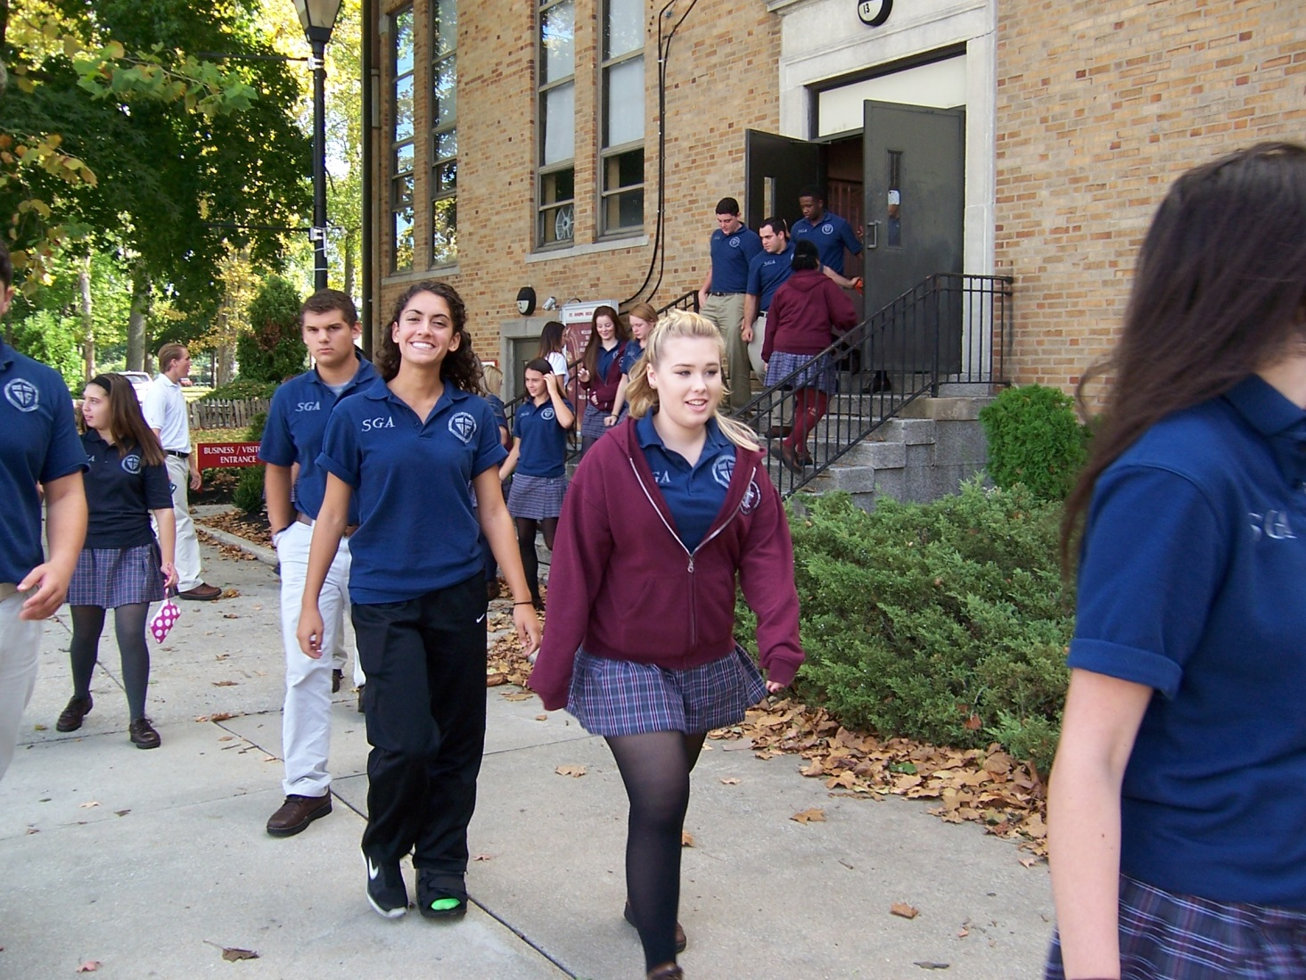
This picture shows the large number of students in the Student Government, which displays the responsibility and intelligence of the St. Joseph student body.

Slide 11
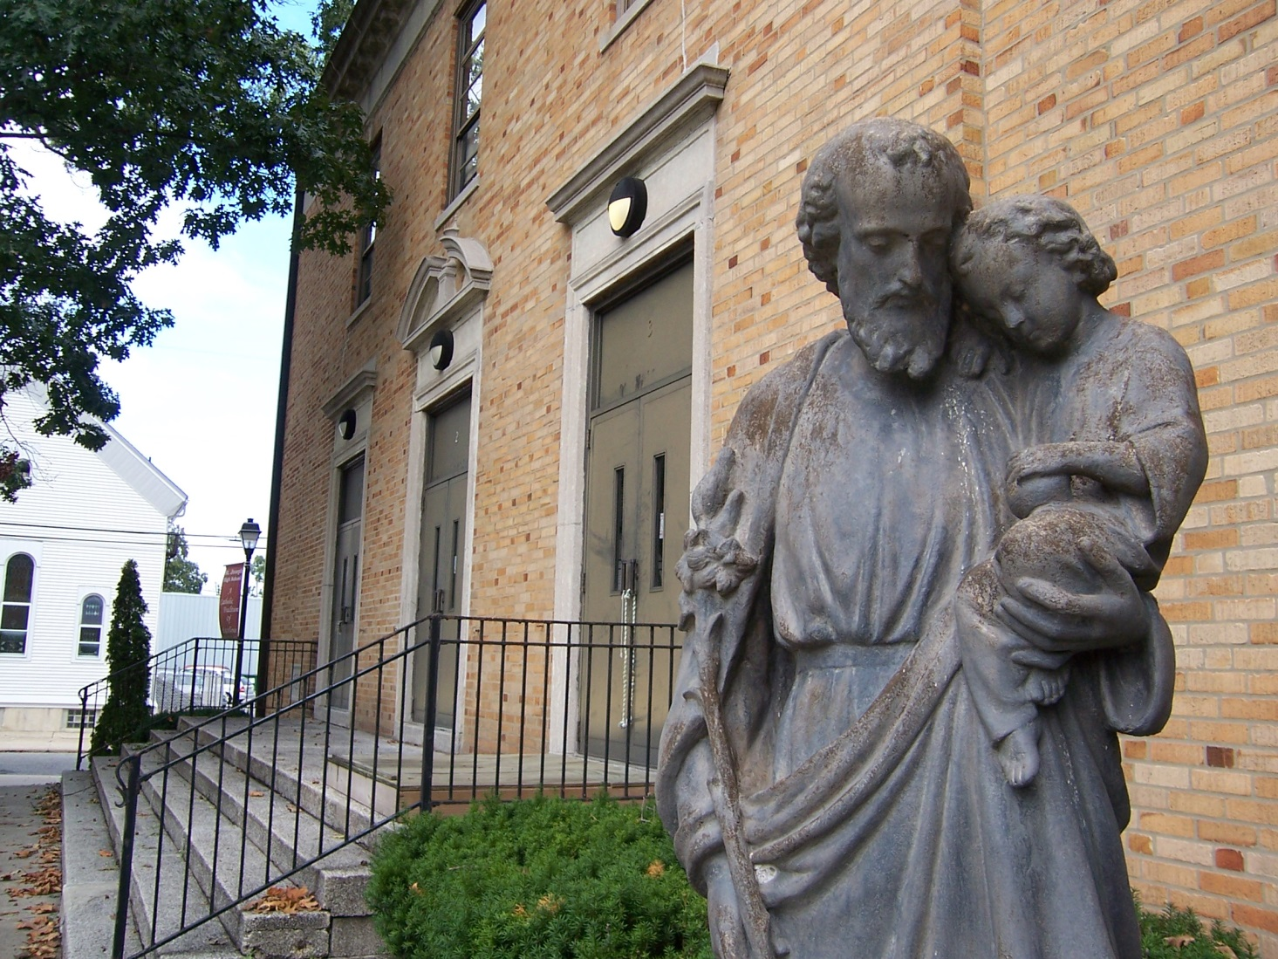
This photo is a representation of the faith, loyalty and truth that we hold at Saint Joseph. This statue perfectly embodies our faith and excellence.

